Slide 1



Precision calculations of atomic and ionic spectra and searches for new physics
Julian Berengut
Solvay Workshop in honour of
Michel Godefroid
26 November 2019
Notes:
Thanks!

Slide 2
Outline
Fundamental physics with atoms
Highly charged ion clocks
EBIT spectroscopy of Pr⁹⁺
CI+MBPT and AMBiT
Isotope shifts and King plot nonlinearities
Notes:
Fundamental constants cannot be predicted by theory and must be measured.
Therefore cannot assume constancy or homogeneity.
Farnsworth: extra dimensions in an expanding universe
Goldilocks: why is the Universe not too hot, not too cold, just right?

Slide 3
Outline
Fundamental physics with atoms
Highly charged ion clocks
EBIT spectroscopy of Pr⁹⁺
CI+MBPT and AMBiT
Isotope shifts and King plot nonlinearities
Notes:
Fundamental constants cannot be predicted by theory and must be measured.
Therefore cannot assume constancy or homogeneity.
Farnsworth: extra dimensions in an expanding universe
Goldilocks: why is the Universe not too hot, not too cold, just right?

Slide 4
Stringent tests of QED
‘Simple’ systems lead to accurate values of fundamental constants and stringent tests of QED.
  Electron, muon magnetic moment “g – 2” in a Penning Trap
  Spectra of hydrogenic species (more recently Li-like)
  Spectrum of muonic hydrogen – proton size puzzle
  Spectrum of antihydrogen – CPT invariance test
  Spectrum of He, He⁺, H₂ , H₂⁺, HD⁺, …
  Strong field QED using g-factor of highly-charged ions
Accuracy levels in the best cases are order 10⁻¹¹

Slide 5
The most accurately measured quantity in physics
The most accurately measured number in physics is a ratio of atomic clock transitions (NIST)¹:
  ν_{Al+}/ν_{Hg+} = 1.052871833148990438 (55)
  (fractional uncertainty 5.2 × 10^{–17})
More recent (RIKEN)²:
  ν_{Yb}/ν_{Sr} = 1.207507039343337749 (55)
  (fractional uncertainty 4.6 × 10^{–17})
Unlike the simpler systems, we cannot calculate the spectrum below around 1% accuracy.
So what can we do with these?
¹Rosenband et al. Science 319, 1808 (2008) ²Nemitz et al. Nat. Photonics 10, 258 (2016)

Slide 6
Fun with atoms in the lab
Atomic parity violation
  Limits running of sin²θ_{W} at low energy; limits on extra Z boson.
Searches for eEDM, nEDM
Tests of Lorentz symmetry, local position invariance, CPT
Limits on time variations of α, μ
Coupling of fundamental constants to gravity; axion or scalar axion-like particle searches (dark matter candidate)
Generally, look for changes under different conditions

Slide 7
Outline
Fundamental physics with atoms
Highly charged ion clocks
EBIT spectroscopy of Pr⁹⁺
CI+MBPT and AMBiT
Isotope shifts and King plot nonlinearities
Notes:
Fundamental constants cannot be predicted by theory and must be measured.
Therefore cannot assume constancy or homogeneity.
Farnsworth: extra dimensions in an expanding universe
Goldilocks: why is the Universe not too hot, not too cold, just right?

Slide 8



α-variation limits from optical atomic clocks
Best current limit (Hg⁺ vs Al⁺):
  Rosenband et al., Science 319, 1808 (2008)
Clock sensitivity to α-variation:
Notes:
NIST group
Shopping list for building a clock with high sensitivity to alpha-variation.
Hg+ is pretty good! Checks all boxes.

Slide 9

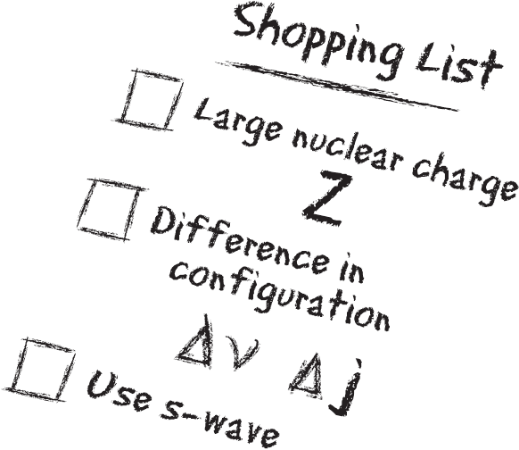


α-variation limits from optical atomic clocks
Best current limit (Hg⁺ vs Al⁺):
  Rosenband et al., Science 319, 1808 (2008)
Clock sensitivity to α-variation:
Hg⁺ clock :
Dzuba, Flambaum, Webb, PRL 82, 888 (1999); Dzuba & Flambaum, PRA 77, 012515 (2008)
Notes:
NIST group
Shopping list for building a clock with high sensitivity to alpha-variation.
Hg+ is pretty good! Checks all boxes.

Slide 10


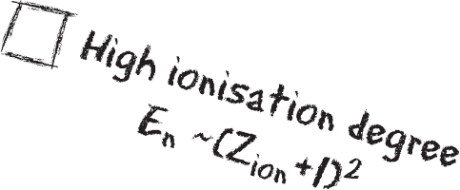
α-sensitivity
Notes:
we thought about it. And we wrote this equation.

Slide 11

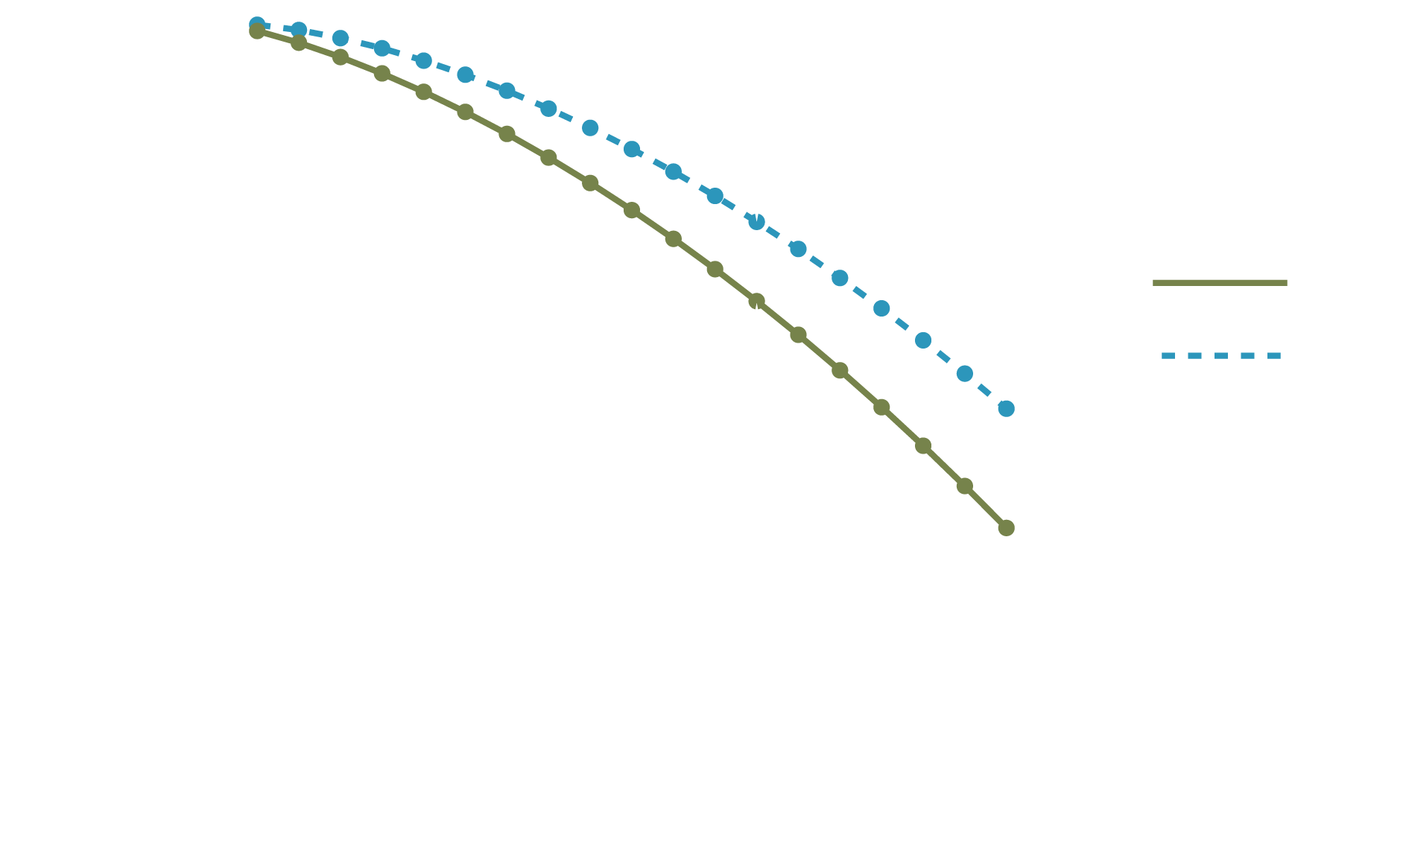
Ag isoelectronic sequence
Notes:
Problem: transition frequencies also grow with ionization energy.
N = 47. Increasing Z along x-axis, Energy (negative of ionization energy) along y-axis.
Typical example: 5s (solid) and 5d_{5/2} (dashed).

Slide 12
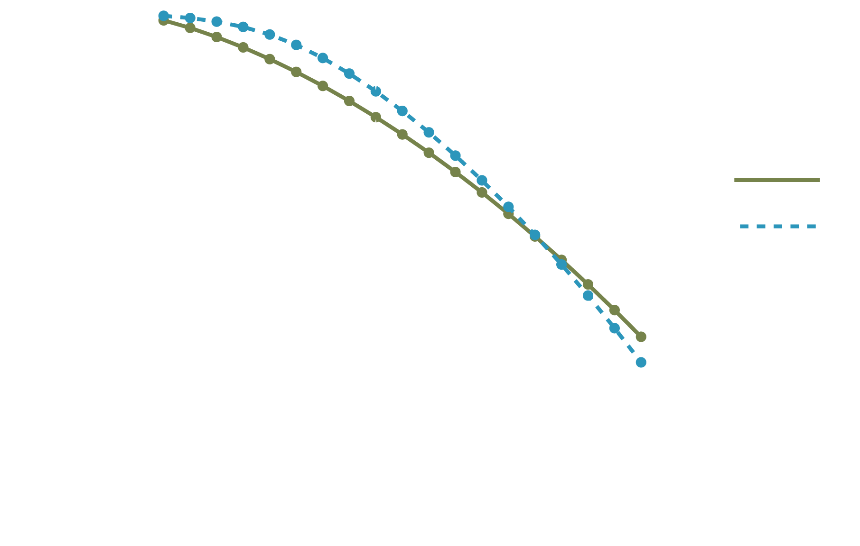

HCI level crossings: Ag isoelectronic sequence
Pm¹⁴⁺
Berengut, Dzuba, Flambaum, PRL 105, 120801 (2010)
Notes:
Solution: configuration crossing as a function of Z.
FOUND optical transitions in Highly charged Ions!
At crossing point, omega can be a few eV, cancellation of I_{n} > 99%
Crossing shown here in Promethium-14+
Samarium, Promethium, Neodymium.

Slide 13
Enhancement of α-variation in HCIs
Notes:
we thought about it. And we wrote this equation.

Slide 14

Clock α-variation sensitivity: q-values (cm⁻¹)
260,000
52,000
1600
Fe⁺
Hg⁺
Sm¹⁴⁺
Berengut, Dzuba, Flambaum, PRL 105, 120801 (2010)
Notes:
5 times larger q-values than Hg⁺/Al⁺ clock comparison
Relative sensitivity enhancement up to 500.
But so what. Sm14+ has two electrons above open shells. Ask Marianna :)

Slide 15
HCI Clock Scaling Laws and Systematics
2nd order Stark shift
Blackbody shift
2nd order Zeeman shift
Electric quadrupole shift
Fine-structure
Hyperfine A coefficient
Proposal: highly charged ion clocks at 10⁻¹⁹ accuracy
1/(Z_{ion}+1)⁴
1/(Z_{ion}+1)⁴
suppressed as 1/ΔE
1/(Z_{ion}+1)²
Z ² (Z_{ion}+1)²/ν³
Z (Z_{ion}+1)²/ν³
Berengut, Dzuba, Flambaum, Ong, PRA 86, 022517 (2012)
Derevianko, Dzuba, Flambaum, PRL 109, 180801 (2012)
Review: Kozlov, Safronova, Crespo, Schmidt, RMP 90, 045005 (2018)

Slide 16
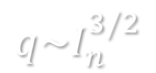
Holes in highly charged ions
Use highly charged ions
Electrons in filled shells have maximal I_{n}
Electron spends half time closer to nucleus than other electrons in the same shell, which increases sensitivity to α-variation
70
85
Z
Use holes in otherwise filled shells
Berengut, Dzuba, Flambaum, Ong, PRL 106, 210802 (2011)

Slide 17

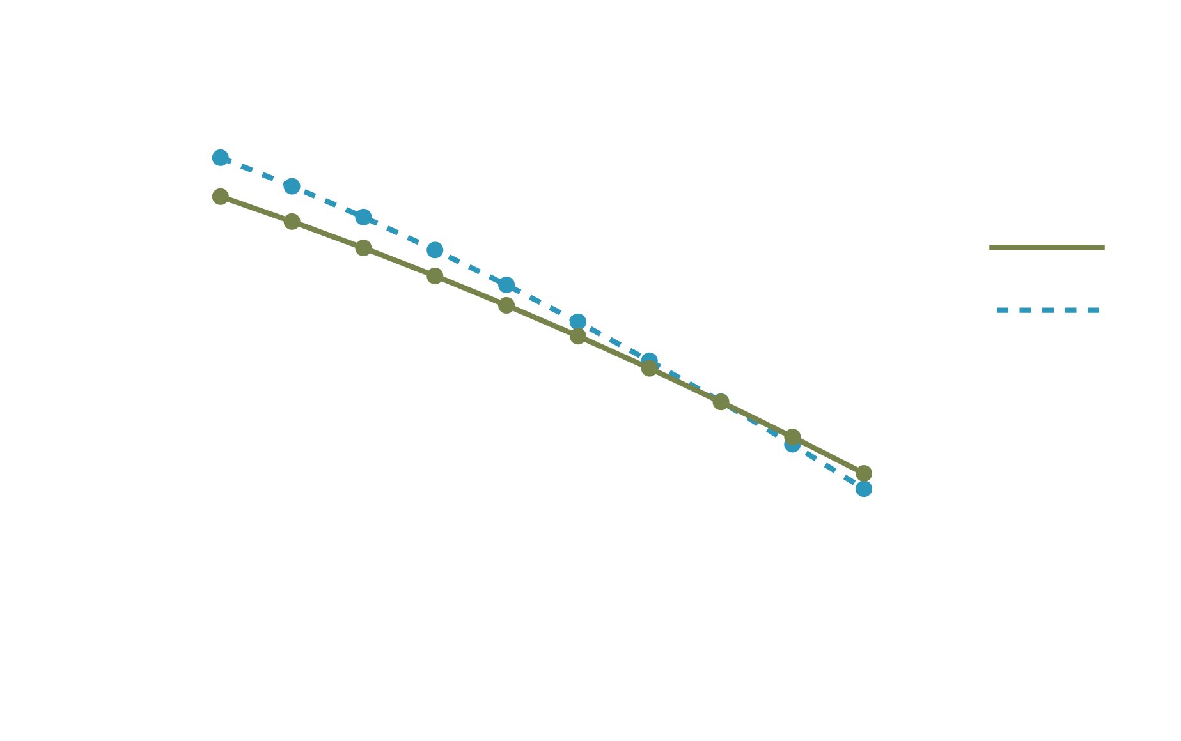

Sm isoelectronic sequence
Ir¹⁵⁺
Berengut, Dzuba, Flambaum, Ong, PRL 106, 210802 (2011)
Notes:
Crossing point at Ir¹⁵⁺ (Z = 77)
Now make a hole or two...

Slide 18
Clock q-values (cm⁻¹)
730,000
260,000
52,000
1600
Fe⁺
Hg⁺
Sm¹⁴⁺
Ir¹⁷⁺
Berengut, Dzuba, Flambaum, Ong, PRL 106, 210802 (2011)

Slide 19
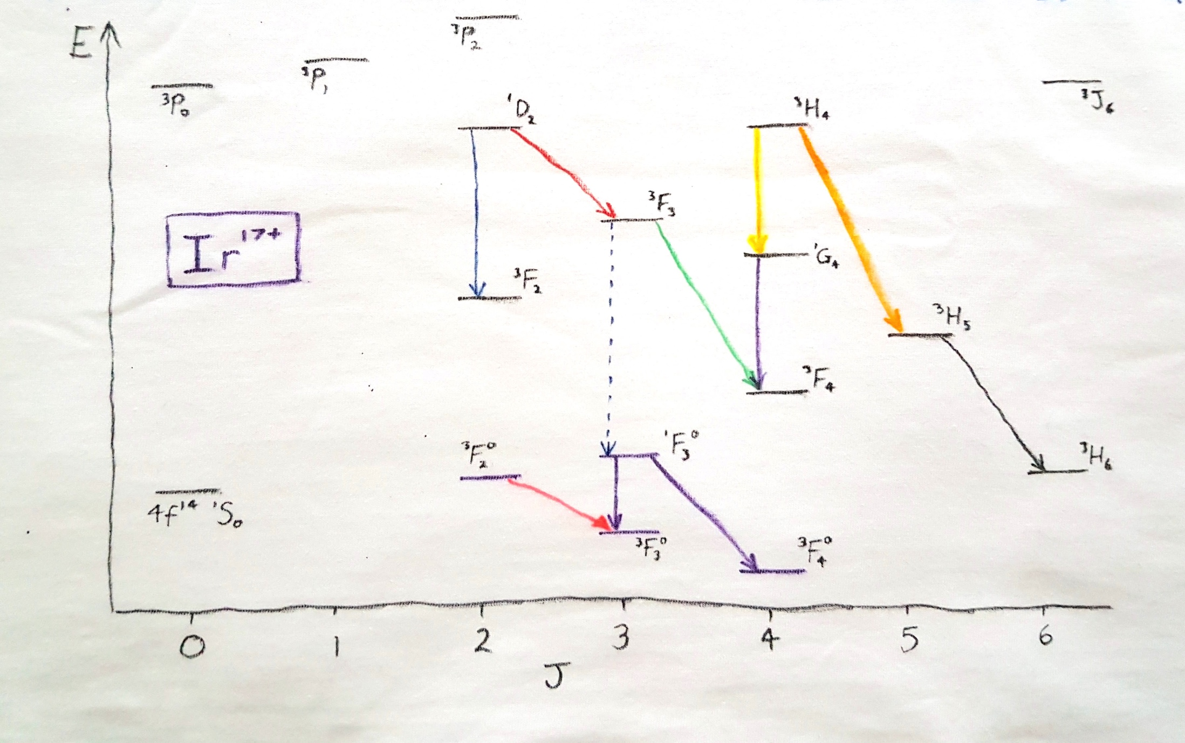
Ir¹⁷⁺ spectrum
4f¹² 5s²
4f¹⁴
4f¹³ 5s
Windberger et al. PRL 114, 150801 (2015)

Slide 20
Finding optical transitions in highly charged ions
Periodic Table Filling
Coulomb Filling
1s
2s
2p
3s
3p
4s
3d
4p
5s
4d
5p
6s
4f
5d
6p
7s
5f
6d
1s
2s
2p
3s
3p
3d
4s
4p
4d
4f
5s
5p
5d
5f
6s
6p
6d
6f
7s
Berengut, Dzuba, Flambaum, Ong, PRA 86, 022517 (2012)
Notes:
Au crossing point at Z > 105

Slide 21
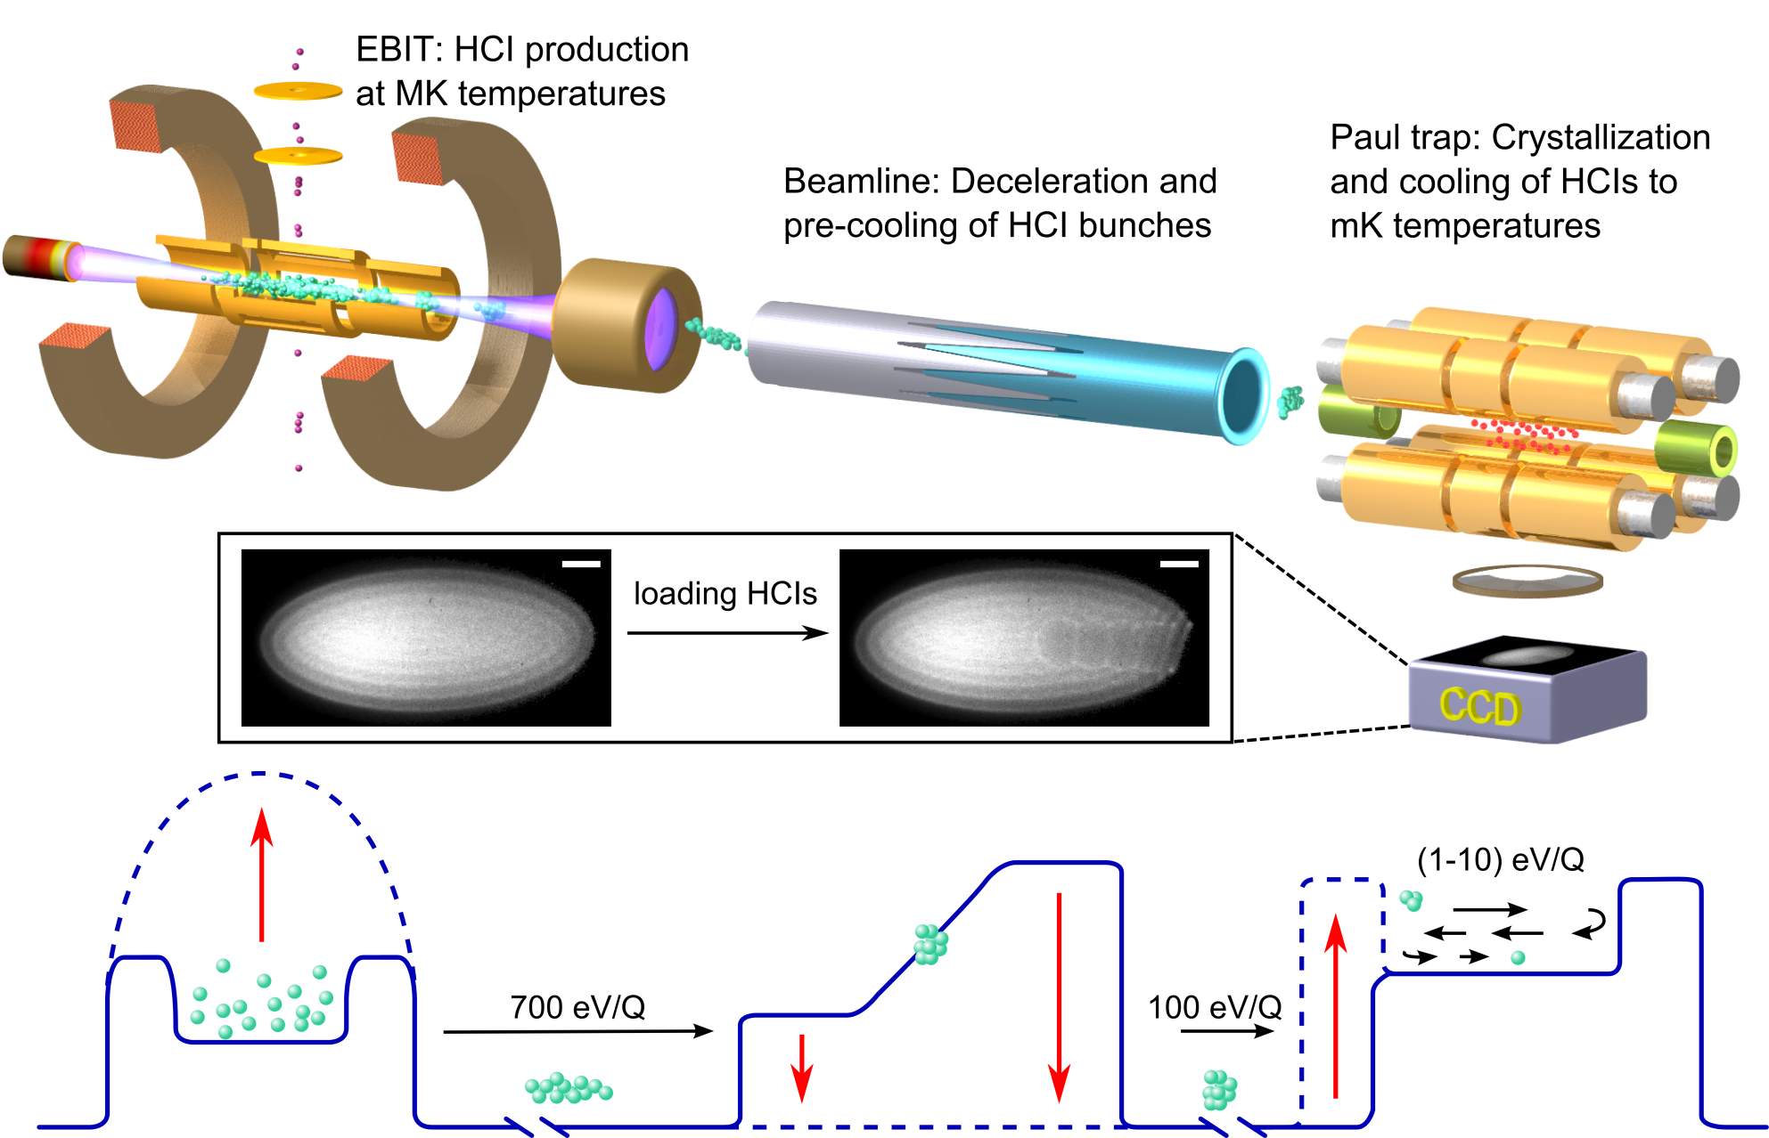
Catch your ion
<1µeV/Q
L. Schmöger et al., Science 347, 6227 (2015); slide courtesy of Lisa Schmöger

Slide 22
Outline
Fundamental physics with atoms
Highly charged ion clocks
EBIT spectroscopy of Pr⁹⁺
CI+MBPT and AMBiT
Isotope shifts and King plot nonlinearities
Notes:
Fundamental constants cannot be predicted by theory and must be measured.
Therefore cannot assume constancy or homogeneity.
Farnsworth: extra dimensions in an expanding universe
Goldilocks: why is the Universe not too hot, not too cold, just right?

Slide 23
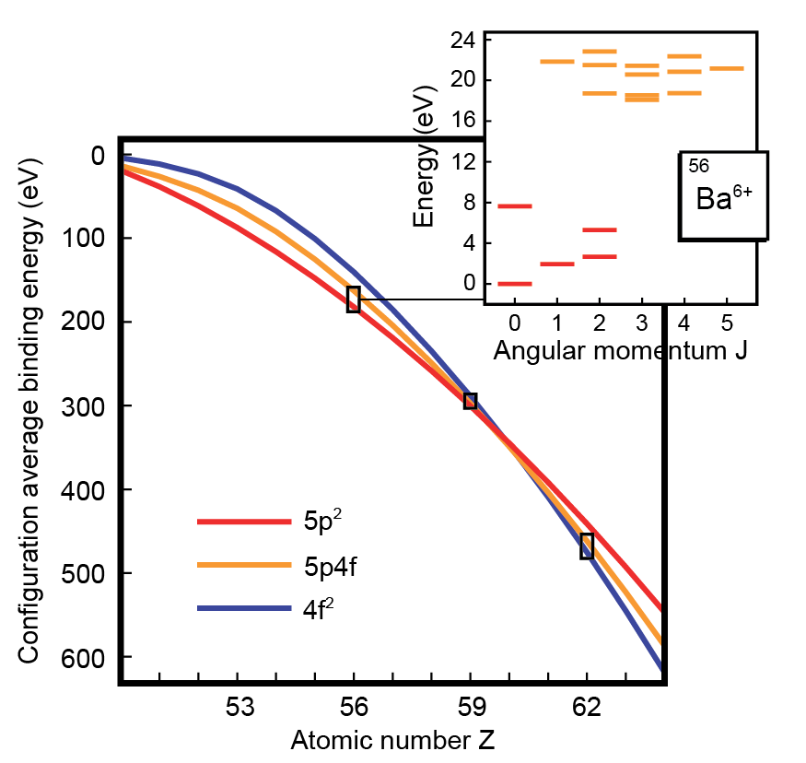
Sn isoelectronic sequence: 5p – 4f crossing

Slide 24
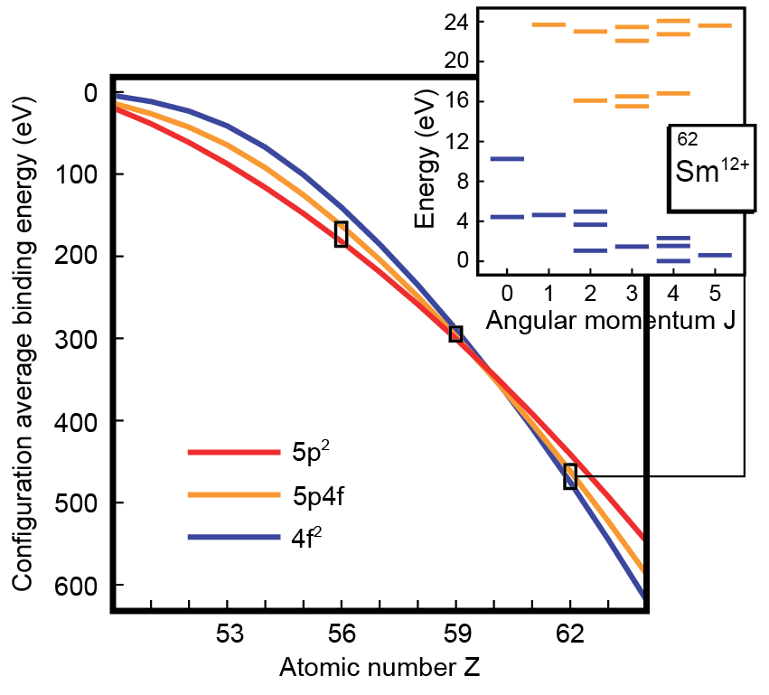
Sn isoelectronic sequence: 5p – 4f crossing

Slide 25
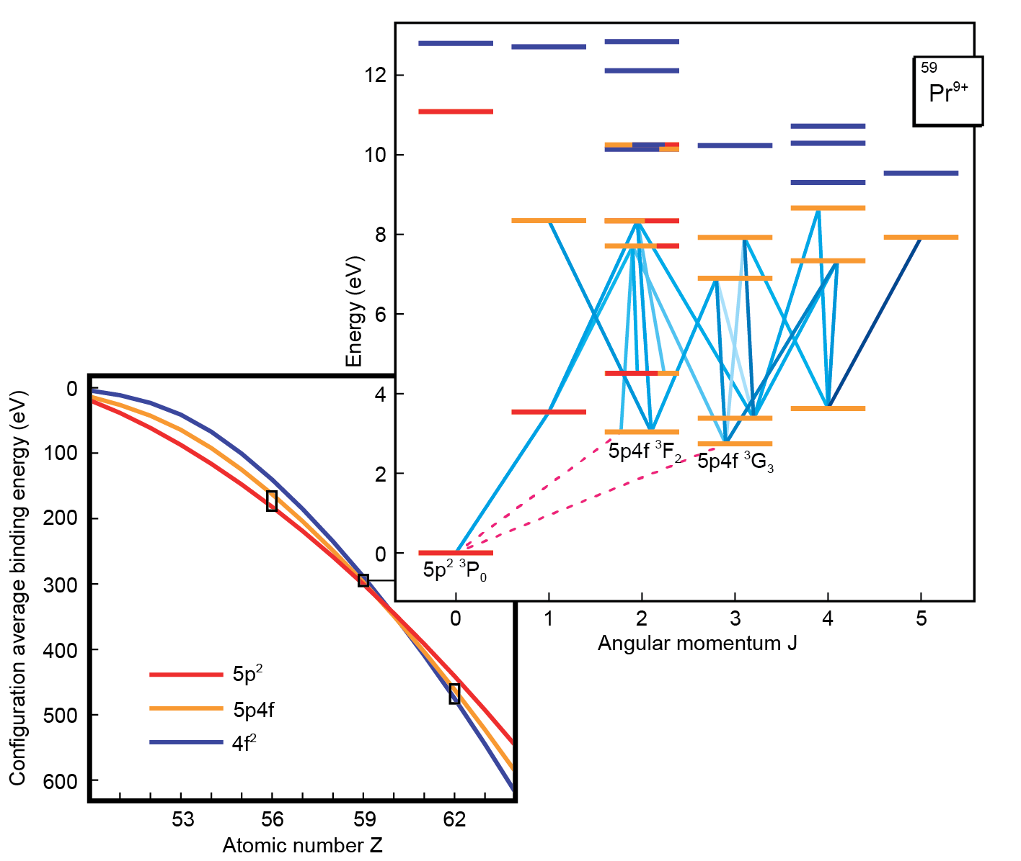
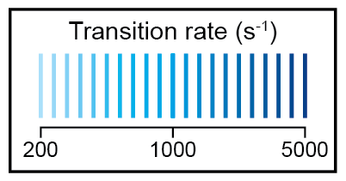
Pr⁹⁺

Slide 26
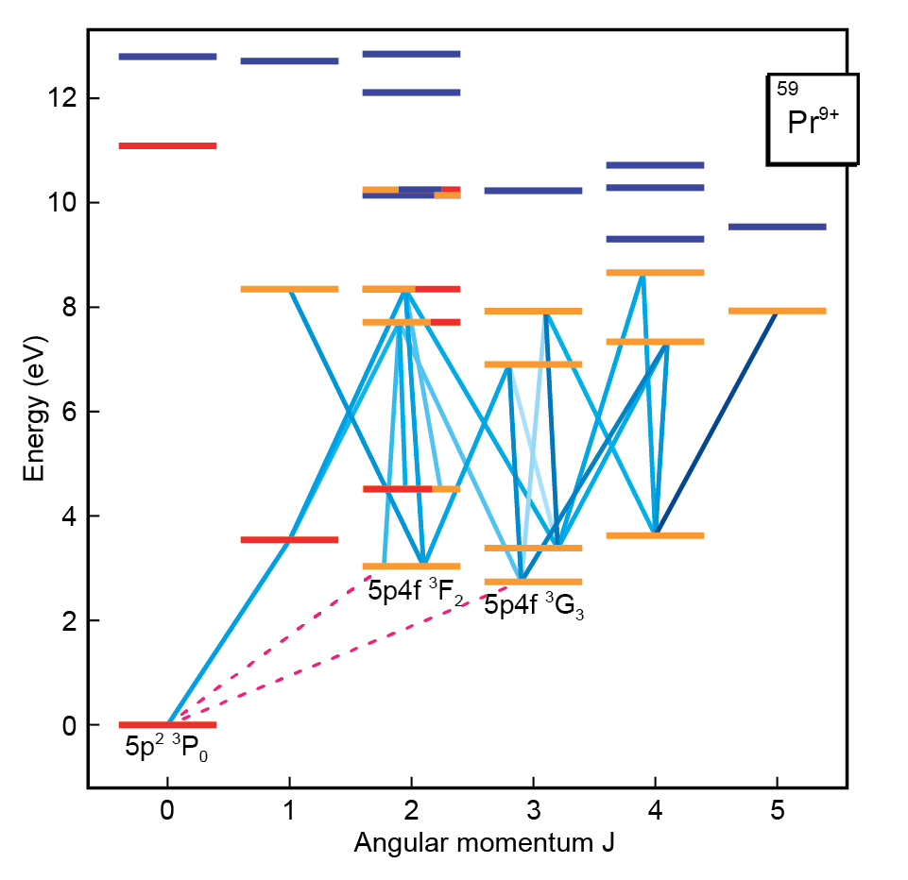
EBIT spectra
Bekker, Borschevsky, Harman, Keitel, Pfeifer, Schmidt, Crespo López-Urrutia, Berengut (accepted Nat. Comm.)
Notes:
Blue expt
Red AMBiT
Orange FSCC

Slide 27
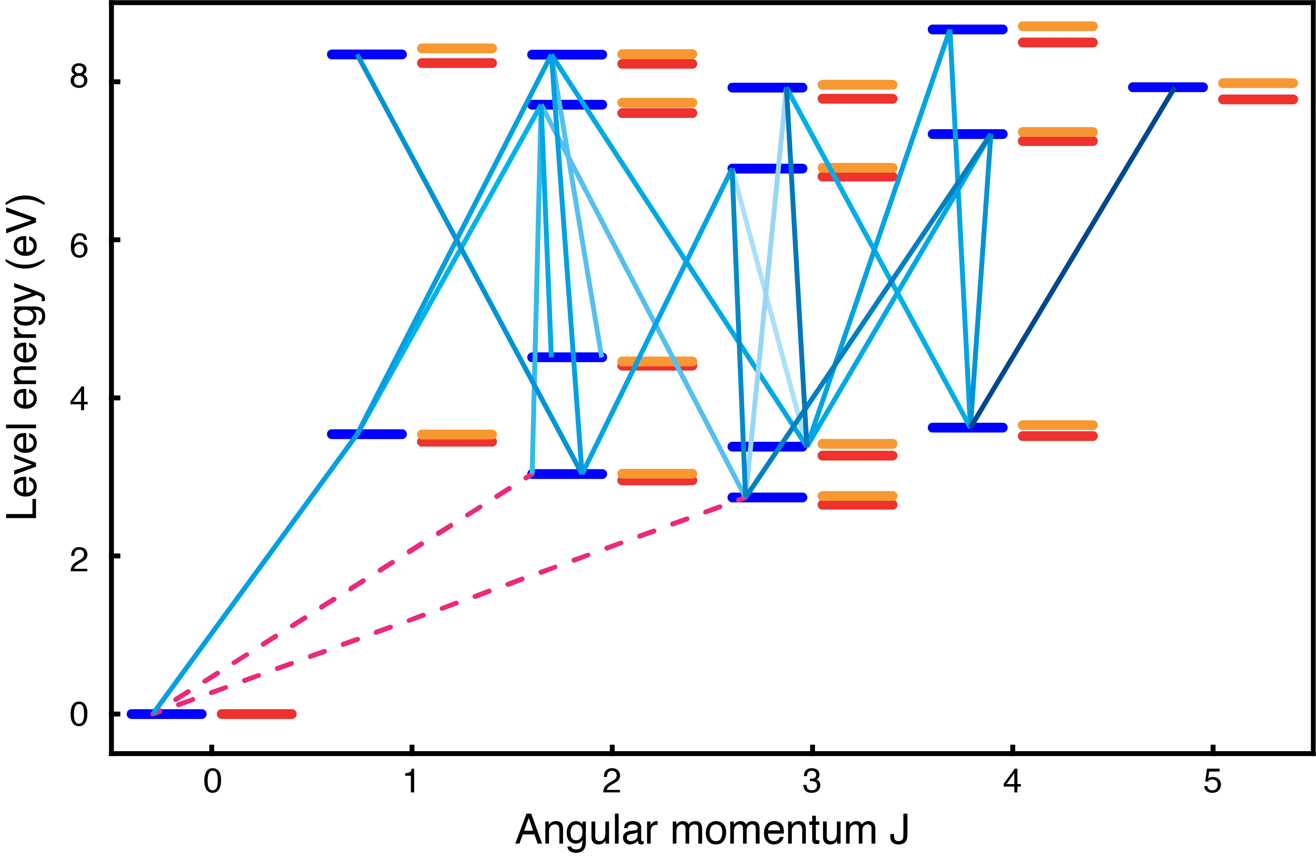
Pr⁹⁺ experiment and theory
Blue: experiment
Red: AMBiT, error -23 (29) meV
Orange: FSCC, error 14 (28) meV
Notes:
Blue expt
Red AMBiT
Orange FSCC

Slide 28
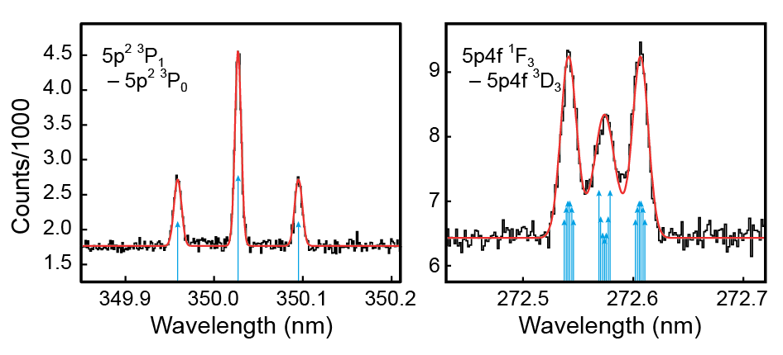
Pr⁹⁺ measured spectrum and fit
Notes:
hyperfine Paschen-Back fit

Slide 29
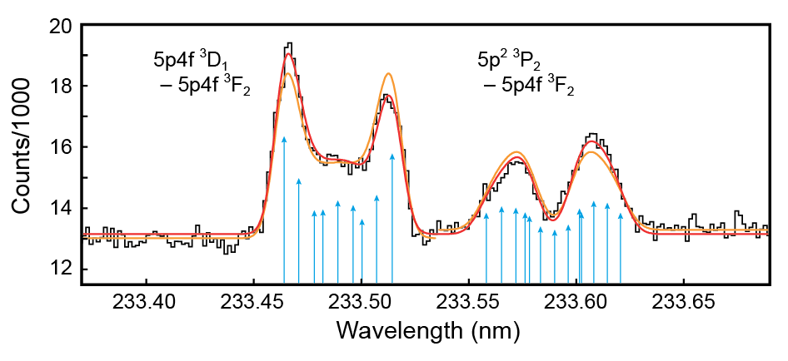
Pr⁹⁺ measured spectrum and fit
Zeeman mixing of upper levels in 8T field
Notes:
hyperfine Paschen-Back fit

Slide 30
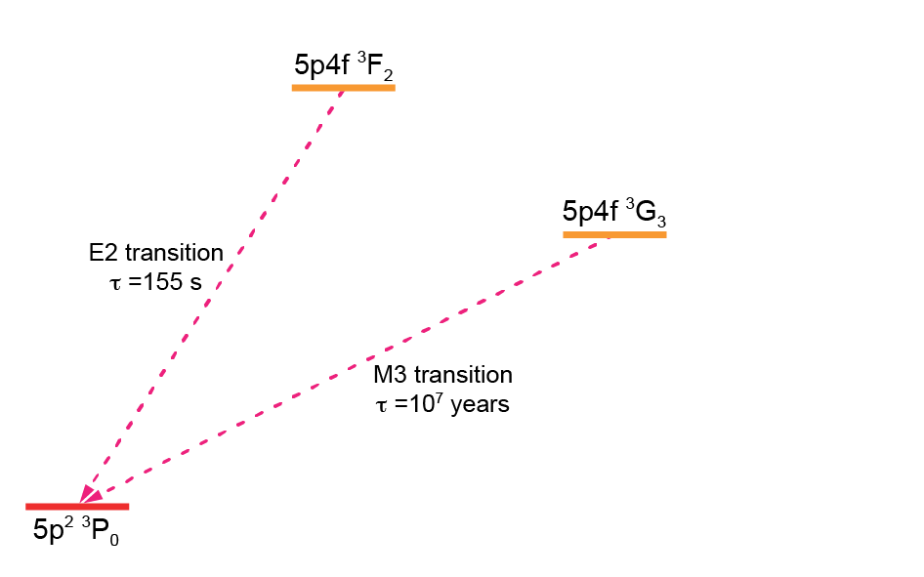
Pr⁹⁺ clock lifetimes
Notes:
hyperfine Paschen-Back fit

Slide 31
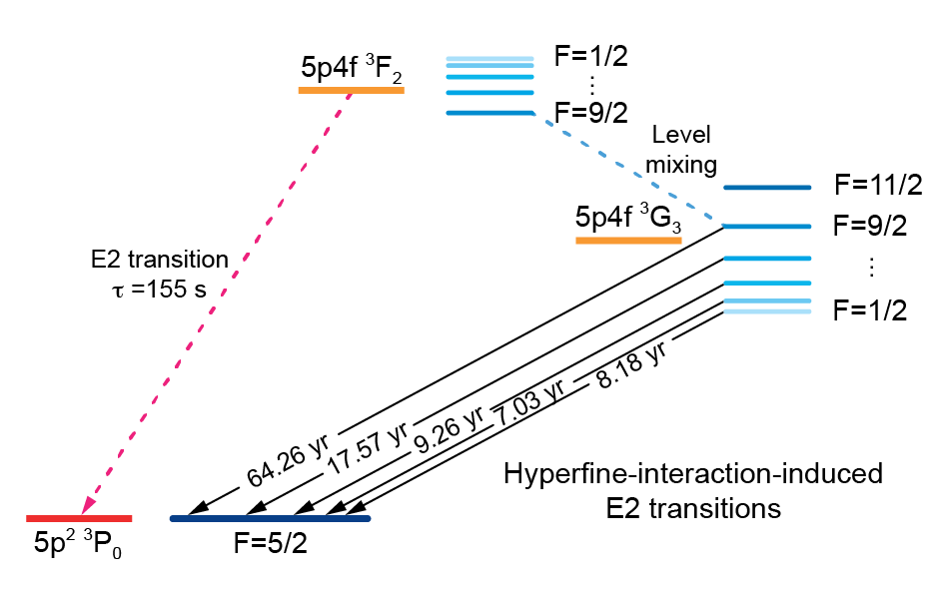
Pr⁹⁺ clock lifetimes: hyperfine mixing
Notes:
hyperfine Paschen-Back fit

Slide 32
Outline
Fundamental physics with atoms
Highly charged ion clocks
EBIT spectroscopy of Pr⁹⁺
CI+MBPT and AMBiT
Isotope shifts and King plot nonlinearities
Notes:
Fundamental constants cannot be predicted by theory and must be measured.
Therefore cannot assume constancy or homogeneity.
Farnsworth: extra dimensions in an expanding universe
Goldilocks: why is the Universe not too hot, not too cold, just right?

Slide 33
AMBiT – atomic structure code
Hole-particle CI + MBPT
Modern C++, parallel, scalable implementation:
  Optimised on your laptop, workstation, or cluster
Very flexible, does lots of fancy things (isotope shift, QED, matrix elements …)
“Nice” interface
Installation via SCons
Documentation (!)
Publicly available at github.com/drjuls/ambit
Kahl and Berengut, CPC 238, 232 (2019)

Slide 34
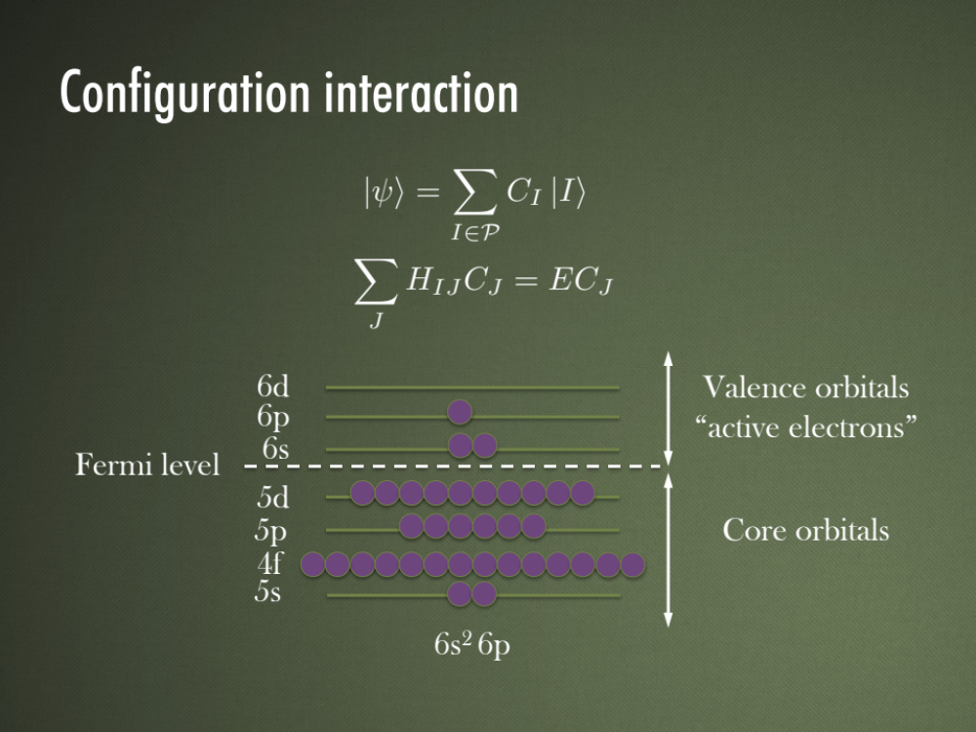


Configuration interaction
6d
Valence orbitals
“active electrons”
6p
6s
Fermi level
5d
5p
Core orbitals
4f
5s
6s² 6p

Slide 35
Configuration interaction
6d
Valence orbitals
“active electrons”
6p
6s
Fermi level
5d
5p
Core orbitals
4f
5s
6s 6p²

Slide 36

Configuration interaction
Configuration
subspace
6d
Valence orbitals
“active electrons”
6p
6s
Fermi level
5d
5p
Core orbitals
4f
5s
6p² 6d

Slide 37
CI+MBPT
Designed for few-valence-electron systems, e.g. Tl (3 electron)
Treat core-valence correlations with MBPT,
valence-valence correlations with CI
6d
Valence orbitals
“active electrons”
6p
6s
Fermi level
5d
5p
Core orbitals
4f
5s
6s² 6p
Dzuba, Flambaum, Kozlov, PRA 54, 3948 (1996)

Slide 38





CI+MBPT
nl
Virtual orbitals
CI+MBPT “trick”: modify slater integrals in :
convert sum over configurations to sum over orbitals
Valence orbitals
“active electrons”
6d
6p
6s
Fermi level
5d
5p
Core orbitals
4f
5s
6s² 6p
Dzuba, Flambaum, Kozlov, PRA 54, 3948 (1996)

Slide 39
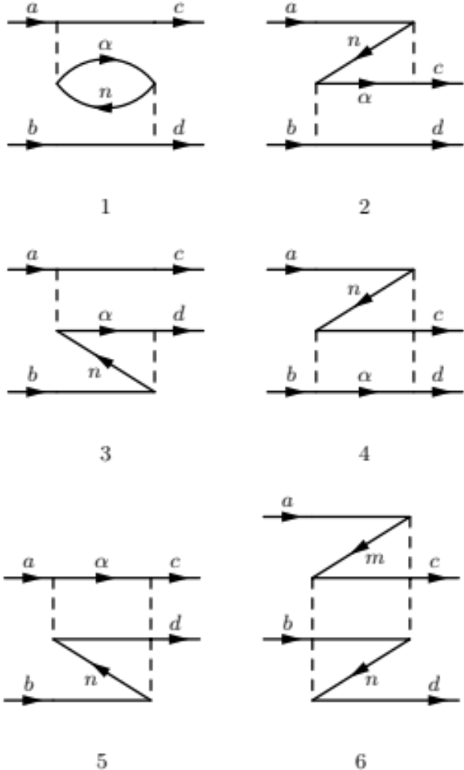
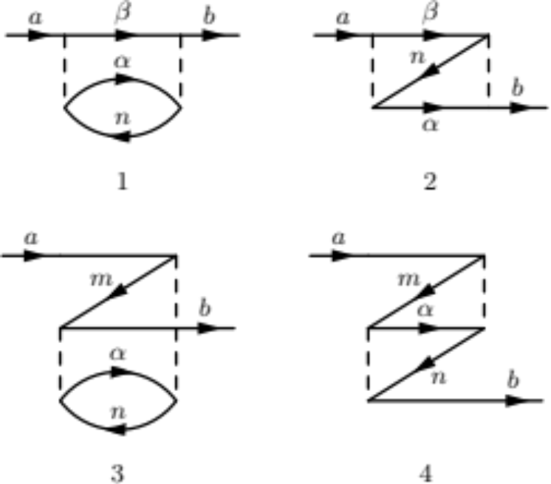
CI+MBPT
Two body diagrams:
One body diagrams:
Dzuba, Flambaum, Kozlov, PRA 54, 3948 (1996)

Slide 40
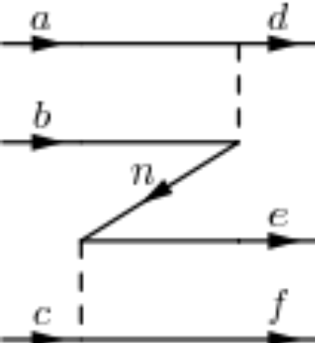
CI+MBPT
Three body diagram:
Dzuba, Flambaum, Kozlov, PRA 54, 3948 (1996)

Slide 41
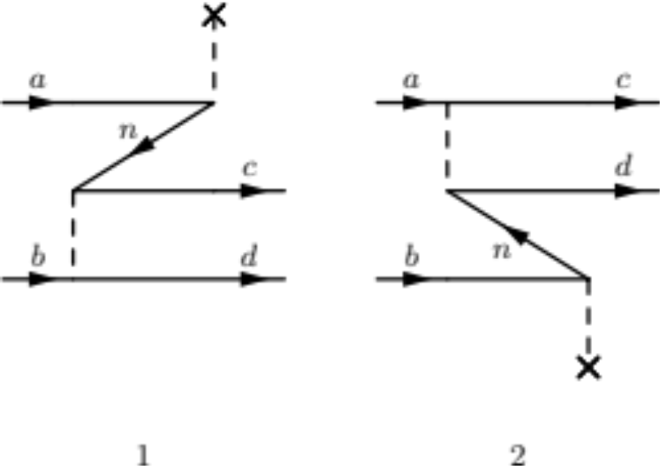
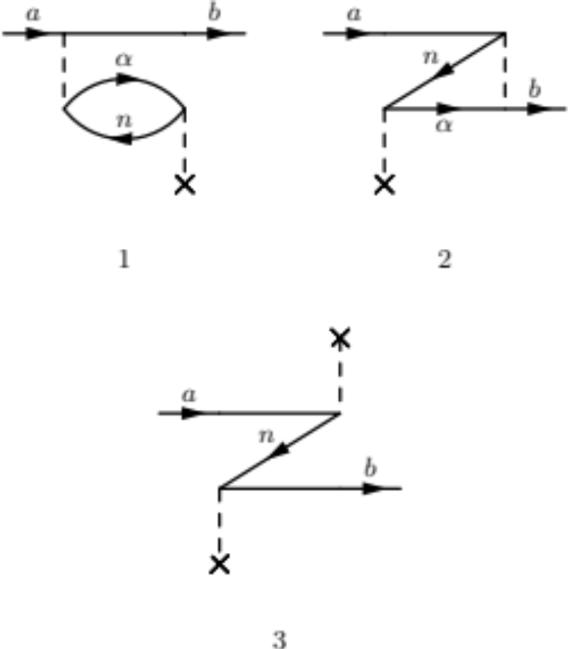
CI+MBPT
Subtraction diagrams:
These can get pretty large for open shell systems: not very perturbative!
Dzuba, Flambaum, Kozlov, PRA 54, 3948 (1996)

Slide 42
CI+MBPT
Subtraction diagrams come from changing basis,
e.g. basis in V^{N-1}, CI in V^{N-3}
Virtual orbitals
6d
Valence orbitals
“active electrons”
6p
6s
Fermi level
5d
5p
Core orbitals
4f
5s
6s² 6p
Dzuba, Flambaum, Kozlov, PRA 54, 3948 (1996)

Slide 43
Particle-hole CI+MBPT
Example: Hg⁺ has 11 active electrons, so very large subtraction diagrams making CI+MBPT not work very well.
6p
6s
5d
5p
5d⁹ 6s²
Berengut, PRA 94, 012502 (2016)

Slide 44
Particle-hole CI+MBPT
Particle-hole CI+MBPT includes valence-valence correlations, three-body diagrams, and large CI basis.
First example system: Hg⁺
6p
6s
5d
5p
5d⁹ 6s²
5d⁻¹ 6s²
Berengut, PRA 94, 012502 (2016)

Slide 45
Particle-hole CI+MBPT
Level | CI+MBPT (cm⁻¹) | Experiment (cm⁻¹)
6s ²S_{1/2} | 0 | 0
5d⁻¹ 6s² ²D_{5/2} | 35121 | 35515
5d⁻¹ 6s² ²D_{3/2} | 50446 | 50556
nl
Virtual orbitals
6d
Valence orbitals
active electrons
and holes
6p
6s
Fermi level
5d
5p
Core orbitals
4f
5s
5d⁻¹ 6s²
Berengut, PRA 94, 012502 (2016)

Slide 46
Sr⁺
Need to include excitations from core 4p shell.
Very small effect on energy, but a large part of SMS!
4d
5s
4p
4s
5s
4p⁻² 4d² 5s

Slide 47
Sr⁺ Specific Mass Shift
Preliminary results with holes: effect of 4p⁻² 4d² nl and
4s⁻² 4d² nl configurations included.
Term | Experiment | MBPT | Particle-hole CI+MBPT
F (MHz/fm²) | -1860 (250) | -1616 (272) | -1591
K_{NMS} (GHz.amu) | -244* | -244 | -244
K_{SMS} (GHz.amu) | -1555 (35) | -1149 (50) | -1673
Total isotope shift (MHz) | 570.281 (4) | 457 (28) | 587

Slide 48
Ar¹³⁺ 2p_{1/2} – 2p_{3/2} Mass Shift
Relativistic transition – huge relativistic contribution!
Energy (cm⁻¹) | NIST | AMBiT
2p_{1/2} – 2p_{3/2} | 22656 | 22653
K (GHz.amu) | Tupitsyn¹ | AMBiT
K_{NMS} (non-relativistic) | -37.908
K_{NMS} (relativistic component) | 29.592
K_{NMS} (total) | -8.316 | -8.24
K_{SMS} (non-relativistic) | 26.712
K_{SMS} (relativistic) | -41.436
K_{SMS} (total) | -14.724 | -15.39
K_{NMS} + K_{SMS} | -23.04 | -23.63
¹Tupitsyn et al. PRA 68, 022511 (2003)

Slide 49

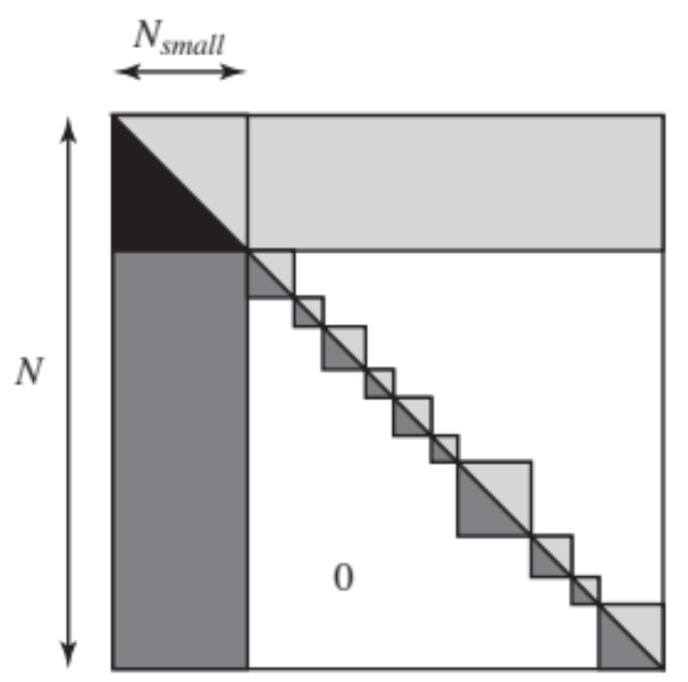


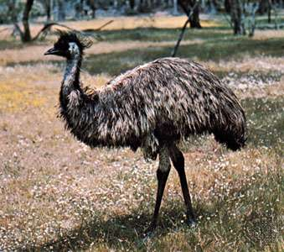
Emu CI
?
?
?
When you really just need a lot of configuration interaction.
?

Slide 50
Emu CI
When you really just need a lot of configuration interaction.
Example: Ta, Db
(5 valence electrons)
including orbitals up to 21spdf for J^{π} = 5/2⁻ uses
N = 952112
N_{small} = 20462
Factor 40 reduction in size and speed
Geddes, Czapski, Kahl, Berengut, PRA 98, 042508 (2018)

Slide 51
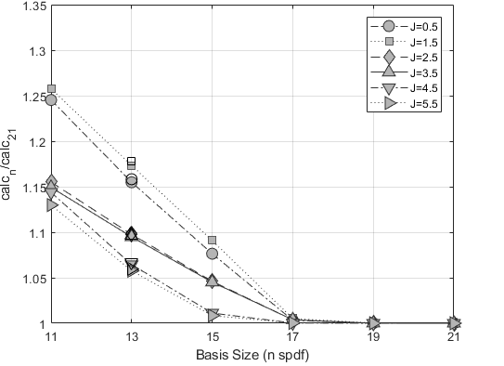
CI+MBPT convergence in AMBiT
Ta: selected even states
Geddes, Czapski, Kahl, Berengut, PRA 98, 042508 (2018)

Slide 52
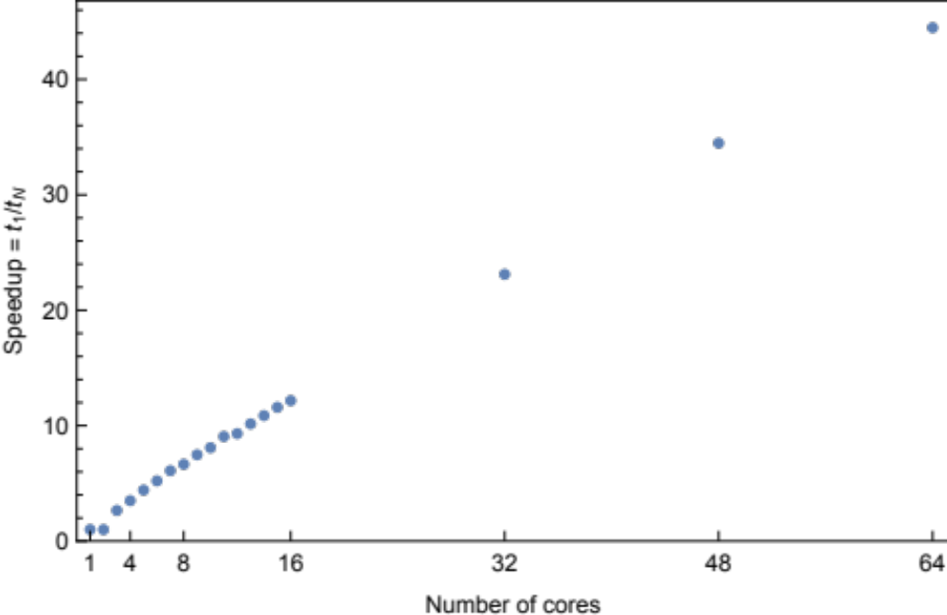
AMBiT Scaling
CI+MBPT scaling in Cr⁺ (16 cores/node)
half an hour
on 4 x 16 cores
24 hours on one processor
Credit: Emily Kahl

Slide 53
Outline
Fundamental physics with atoms
Highly charged ion clocks
EBIT spectroscopy of Pr⁹⁺
CI+MBPT and AMBiT
Isotope shifts and King plot nonlinearities
Notes:
Fundamental constants cannot be predicted by theory and must be measured.
Therefore cannot assume constancy or homogeneity.
Farnsworth: extra dimensions in an expanding universe
Goldilocks: why is the Universe not too hot, not too cold, just right?

Slide 54
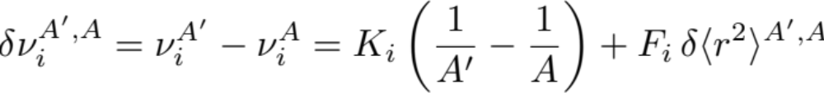
Isotope shift: theory
In the “standard theory” we express the difference between frequencies of isotope with mass number A and A’ by
We have factorized the nuclear part and electron parts of each term.
δ<r²> – change in nuclear charge radius – is hard to measure; we can extract it from isotope shift if the electronic factors (F_{i} , K_{i} ) can be calculated accurately.
“Mass shift”
nuclear recoil
“Field shift”
charge distribution

Slide 55
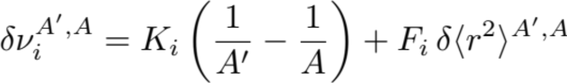



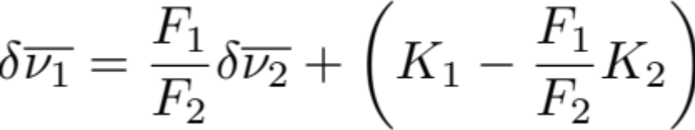
King plot
Remove dependence on δ<r²> by cancelling it between two transitions.
Introduce “modified” isotope shifts:
Plot vs for several pairs of isotopes (A’, A):

Slide 56
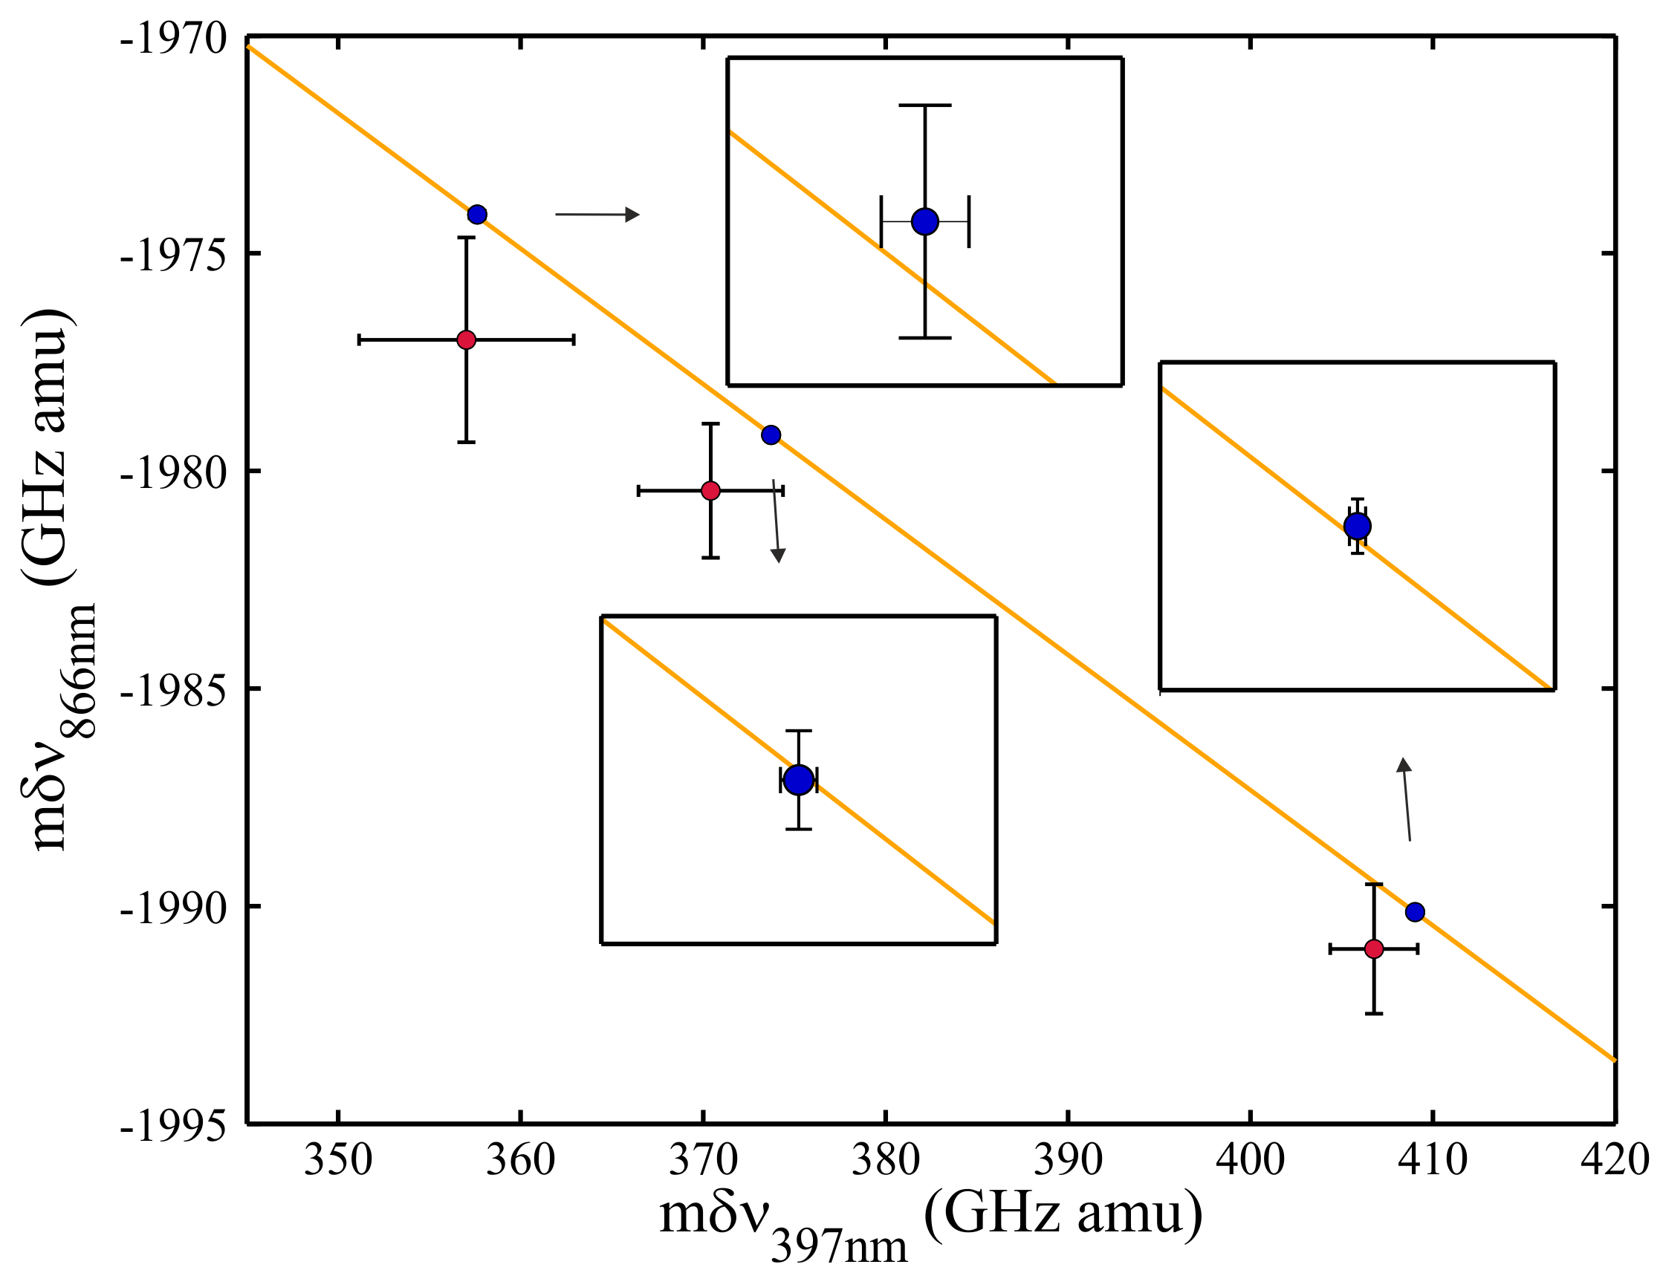
King plot: Ca⁺
Gebert, Wan, Wolf, Angstmann, Berengut, Schmidt, PRL 115, 053003 (2015)
Notes:
Linear at ~100kHz; need 4 isotopes

Slide 57
King plot nonlinearities
What if the King plot is not linear?
May point to new physics in complex atoms that are beyond theoretical description at 7+ digits (e.g. Ca⁺, Sr/Sr⁺, Yb/Yb⁺)
Also many Standard Model sources of nonlinearities of size unknown in complex atoms.
Berengut, Budker, Delaunay, Flambaum, Frugiuele, Fuchs, Grojean, Harnik, Ozeri, Perez, Soreq. PRL 120, 091801 (2018)

Slide 58
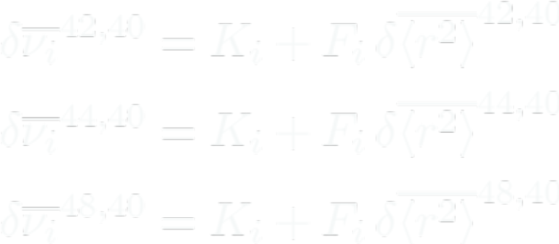

New physics searches with isotope shift
Start with reformulation of King plot
Berengut, Budker, Delaunay, Flambaum, Frugiuele, Fuchs, Grojean, Harnik, Ozeri, Perez, Soreq. PRL 120, 091801 (2018)

Slide 59
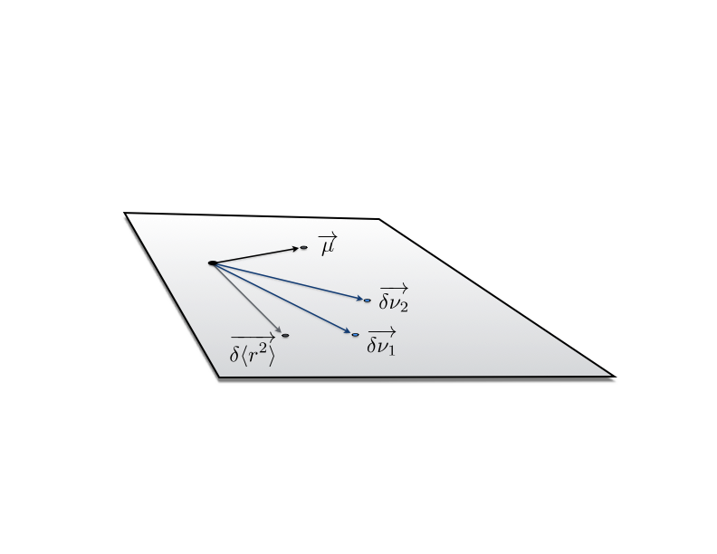

New physics searches with isotope shift
Start with reformulation of King plot
Modified isotope shifts of all transitions lie in the same
2-D plane in the (N-1) dimensional space
Berengut et al. PRL 120, 091801 (2018)

Slide 60




New physics searches with isotope shift
Reduced isotope shift again:
No sensitivity to new physics if or
Berengut et al. PRL 120, 091801 (2018)

Slide 61

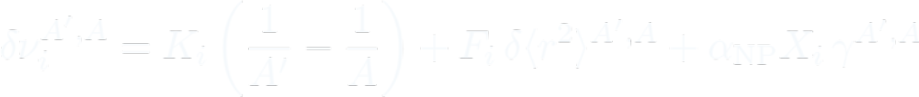

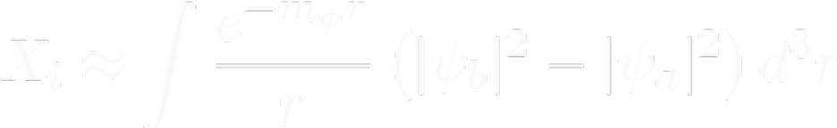
New physics searches with isotope shift
Example: new force-carrying light boson couples electrons to neutrons with Yukawa potential
Isotope shift has extra term
For light scalar case
Berengut et al. PRL 120, 091801 (2018)

Slide 62
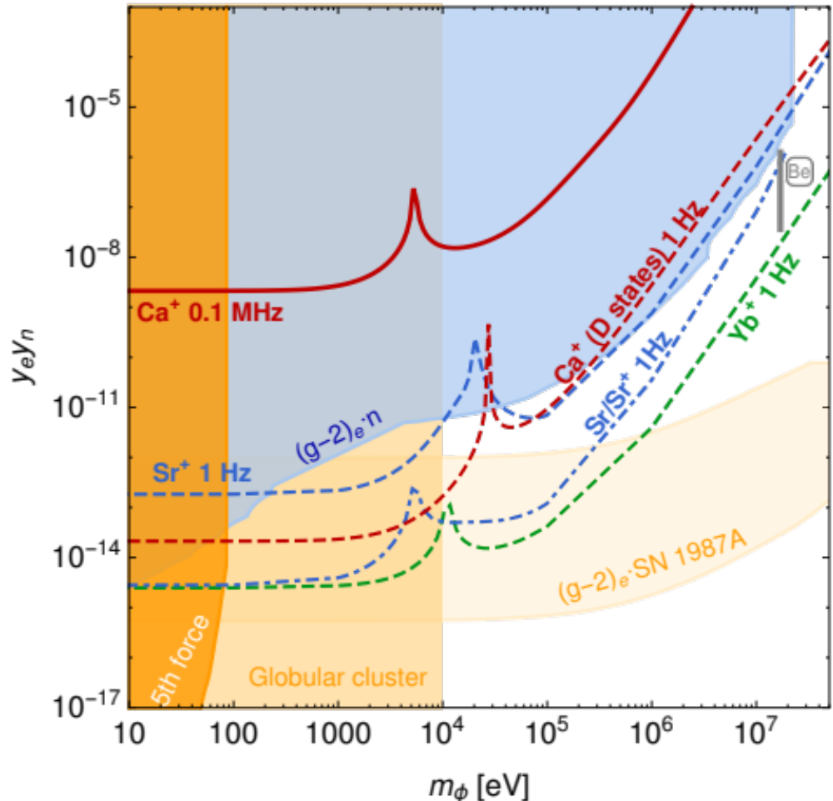
New physics searches with isotope shift
Berengut et al. PRL 120, 091801 (2018)

Slide 63
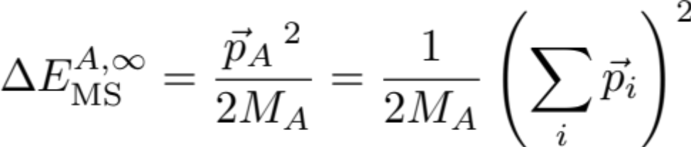
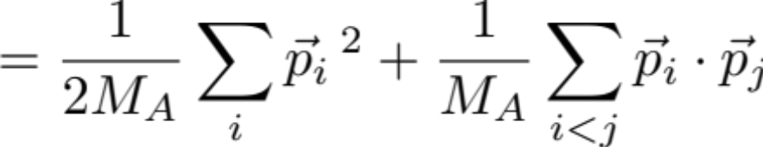
Mass Shift
The mass shift term K_{i} is due to nuclear recoil
“normal
mass shift”
“specific
mass shift”

Slide 64
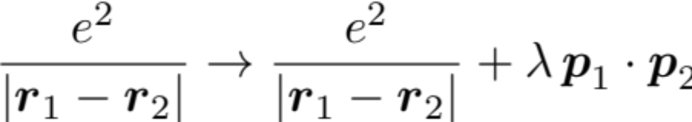
Specific mass shift calculation
We add a finite-field SMS term everywhere that the Coulomb operator appears:
“All order” in SMS
Berengut, Dzuba, Flambaum, PRA 68, 022502 (2003)

Slide 65
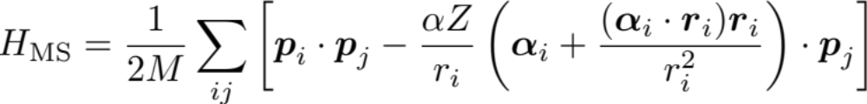
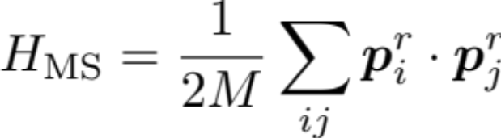
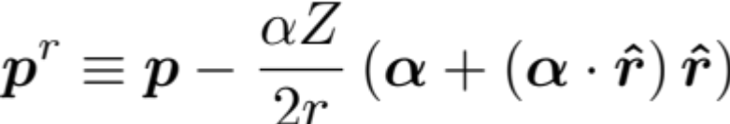
Specific mass shift calculation
More recently we made it relativistic following the formulation of Shabaev and collaborators
We implement by changing the momentum operator
Very important for accurate fine-structure isotope shift in Ca⁺
Shabaev, PRA 57, 59 (1998)

Slide 66



Sr⁺ Specific Mass Shift
Isotope shift measurement of 5s – 4d_{5/2} transition in Sr⁺:
Combine with previous measurement of
(Barwood et al. 2003) and known
Term | Experiment | Theory
F (MHz/fm²) | -1860 (250) | -1616 (272)
K_{NMS} (GHz.amu) | -244* | -244
K_{SMS} (GHz.amu) | -1555 (35) | -1149 (50)
Total isotope shift (MHz) | 570.281 (4) | 457 (28)
Serious discrepancy in K_{SMS}
Lybarger, Berengut, Chiaverini, PRA 83, 052509 (2011)

Slide 67
Sr⁺
Need to include excitations from core 4p shell.
Very small effect on energy, but a large part of SMS!
4d
5s
4p
4s
5s
4p⁻² 4d² 5s

Slide 68
Sr⁺ Specific Mass Shift
Preliminary results with holes: effect of 4p⁻² 4d² nl and
4s⁻² 4d² nl configurations included.
Term | Experiment | MBPT | Particle-hole CI+MBPT
F (MHz/fm²) | -1860 (250) | -1616 (272) | -1591
K_{NMS} (GHz.amu) | -244* | -244 | -244
K_{SMS} (GHz.amu) | -1555 (35) | -1149 (50) | -1673
Total isotope shift (MHz) | 570.281 (4) | 457 (28) | 587

Slide 69
Ar¹³⁺ 2p_{1/2} – 2p_{3/2} Mass Shift
Relativistic transition – huge relativistic contribution!
Energy (cm⁻¹) | NIST | AMBiT
2p_{1/2} – 2p_{3/2} | 22656 | 22653
K (GHz.amu) | Tupitsyn¹ | AMBiT
K_{NMS} (non-relativistic) | -37.908
K_{NMS} (relativistic component) | 29.592
K_{NMS} (total) | -8.316 | -8.24
K_{SMS} (non-relativistic) | 26.712
K_{SMS} (relativistic) | -41.436
K_{SMS} (total) | -14.724 | -15.39
K_{NMS} + K_{SMS} | -23.04 | -23.63
¹Tupitsyn et al. PRA 68, 022511 (2003)

