Slide 1


The Implications of a Positive Cosmological Constant on Electromagnetic Theory
Andrés Gomberoff
U. Mayor
Solvay Workshop on
Progress on Gravitational Physics
45 years of Belgian-Chilean Collaboration

Slide 2
The issues
Generalized conserved charges (BMS-like) are absent.
Electromagnetic “Memory”
In the presence of magnetic and electric charges, energy fluxes at the asymptotic region infinity are unavoidable.
Outgoing radiation at spatial infinity appears to bring energy into the system (negative refraction index of de Sitter space).

Slide 3
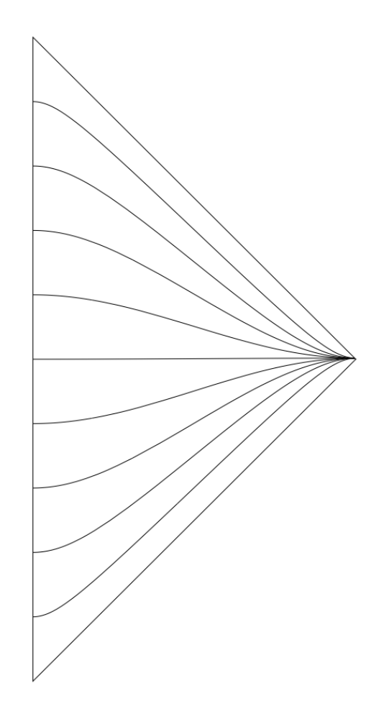





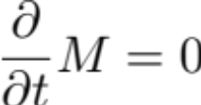

Slide 4
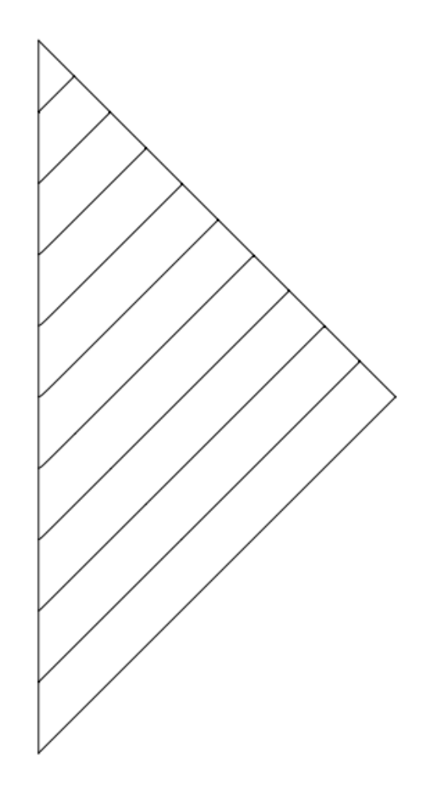

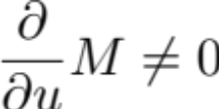

Slide 5
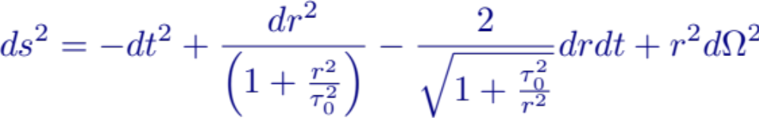
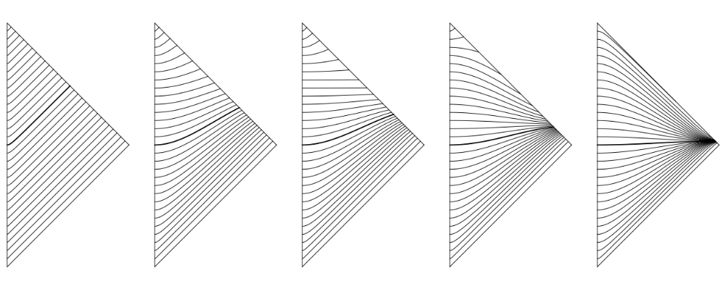

Hourglass coordinates
(Bunster, Gomberoff, Pérez 2019)
Increasing curvature radius of slicing

Slide 6
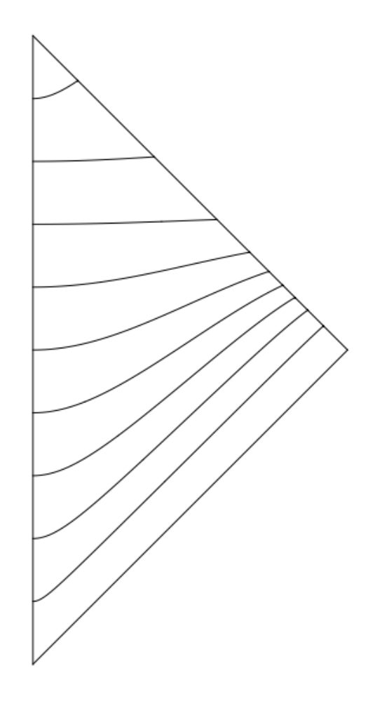
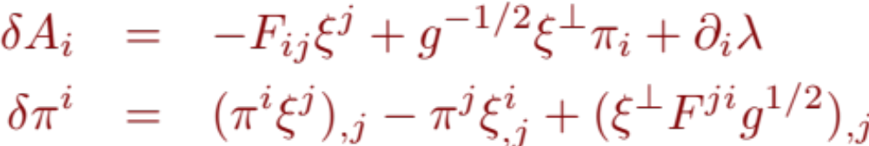
Electromagnetism on null infinity
The Maxwell Equations

Slide 7
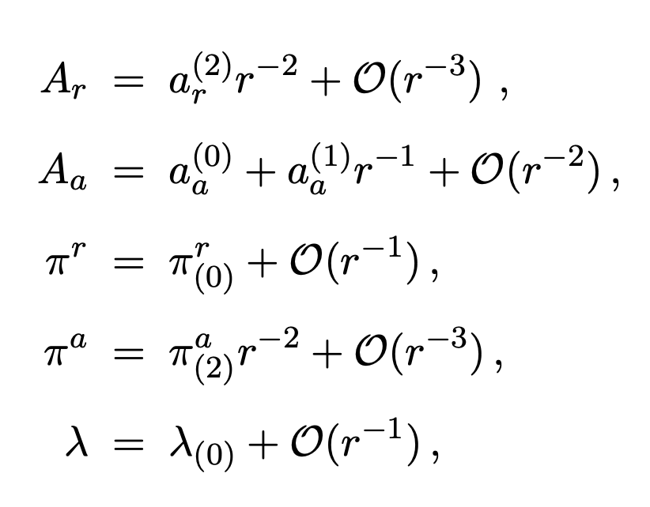
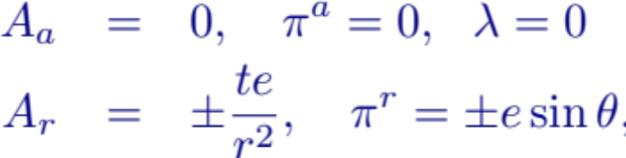
Falloff conditions
Coulomb
solution

Slide 8

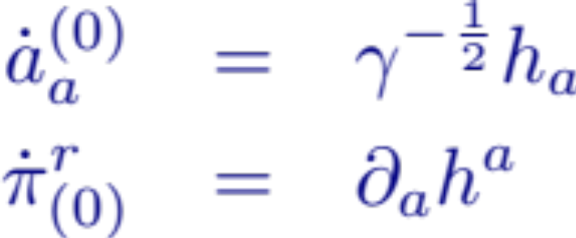
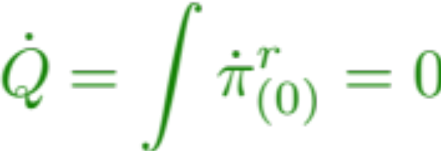
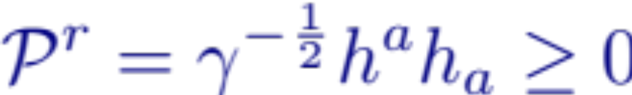
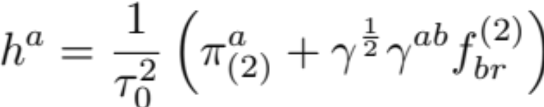
(“Electromagnetic news”)
(vanishes for magnetic and electric charges along geodesics)

Slide 9
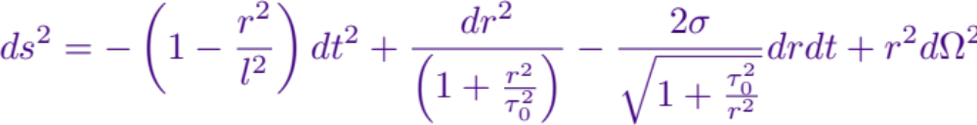
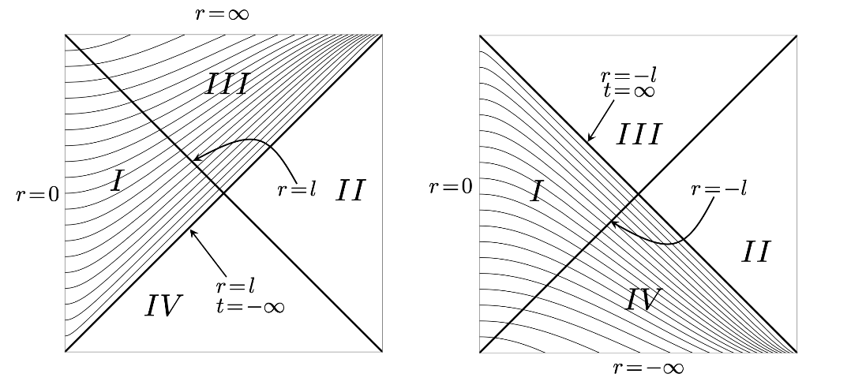
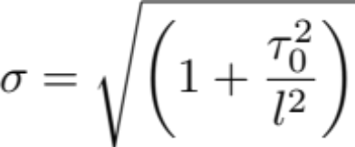
de Sitter Space in hyperbolic coordinates

Slide 10
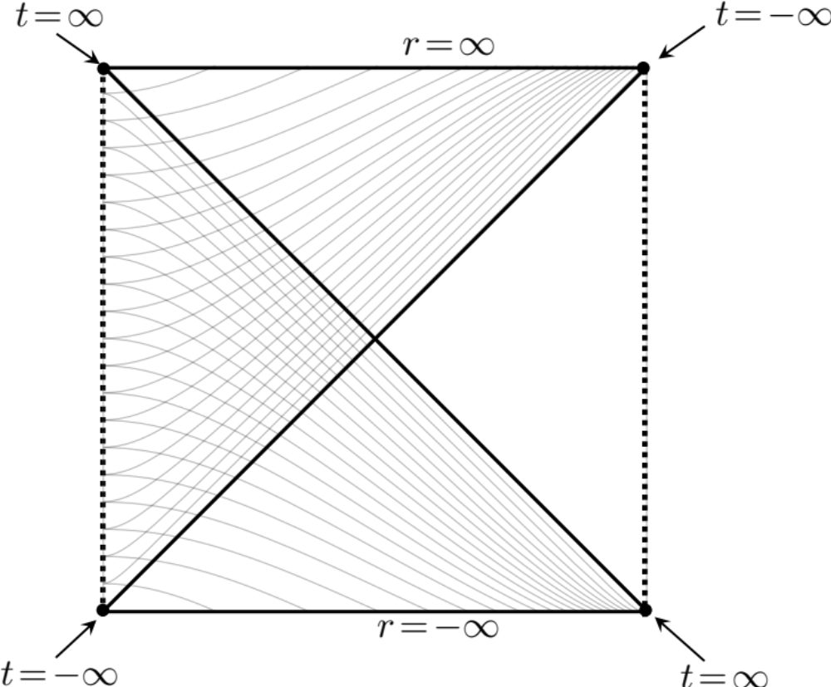
Electromagnetism on spacelike infinity
Falloff conditions
Coulomb
solution

Slide 11
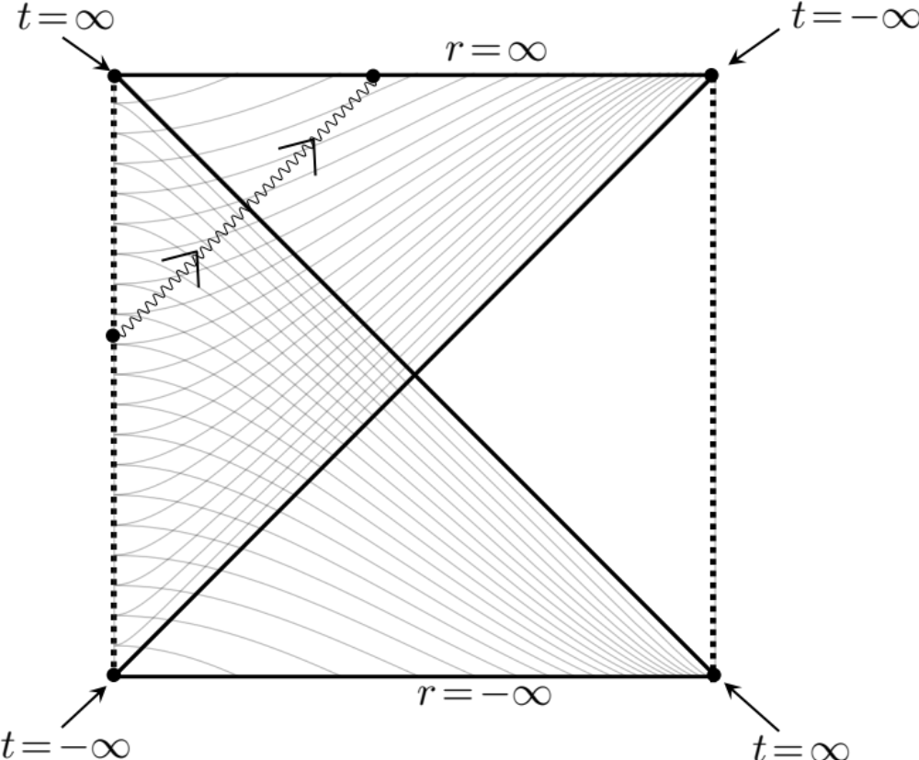

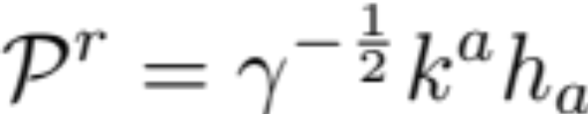
Electromagnetism on spacelike infinity
¿Who brings the news?

Slide 12


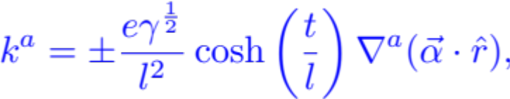
¿Who brings the news?
Coulomb
solution
De Sitter transformation
“Boosted”
Coulomb
solution
Longitudinal on the sphere

Slide 13

is not bringing the news

Slide 14


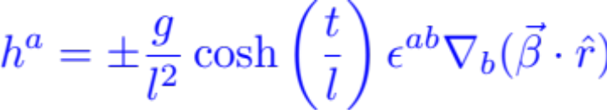
¿Who brings the news?
Magnetic
monopole
De Sitter transformation
“Boosted”
Monopole
solution
Transverse on the sphere

Slide 15

Neither does

Slide 16


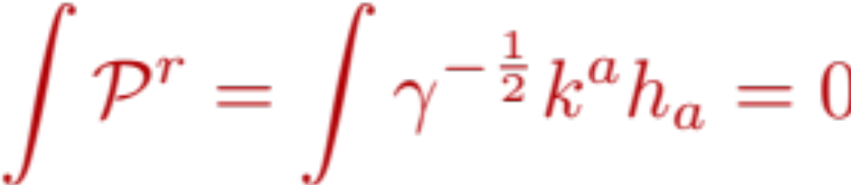
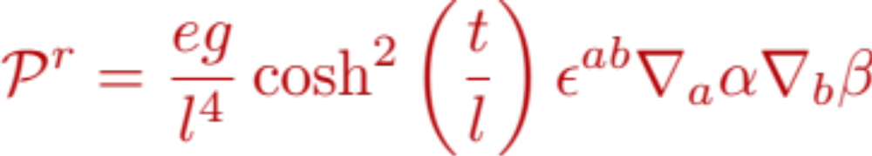
Therefore:
In the presence of geodesically moving electric charges but not magnetic poles (or vice-versa), the Poynting vector vanishes in the boundary,
In the presence of both magnetic and electric charges
However, it turns out that the total flux in this case vanishes,
An example, with one charge and one monopole:

Slide 17


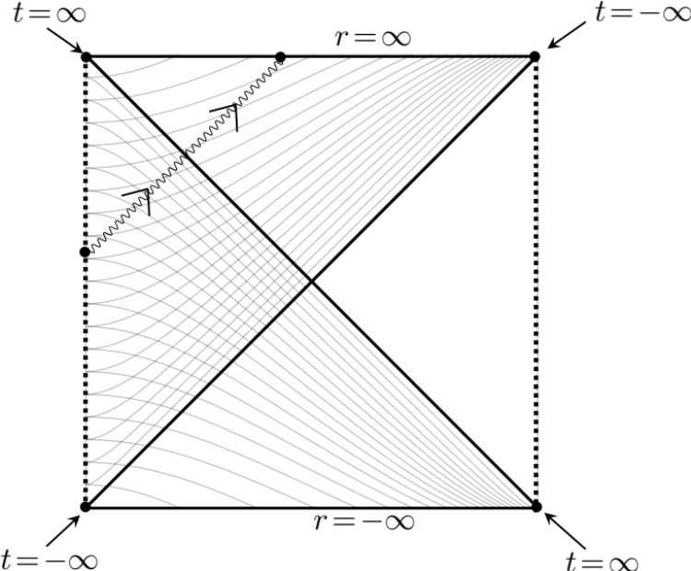



The news is brought by the transversal part of and the longitudinal of
The charges are not conserved anymore
In the absence of news , the longitudinal part of is conserved. Therefore in de Sitter we have “memory” but not the (extended) charge conservation.
(plus a magnetic counterpart)

Slide 18
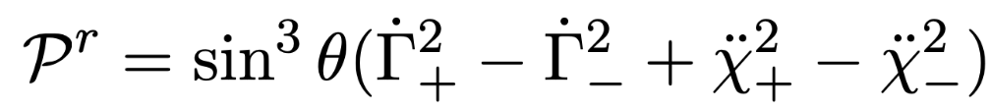
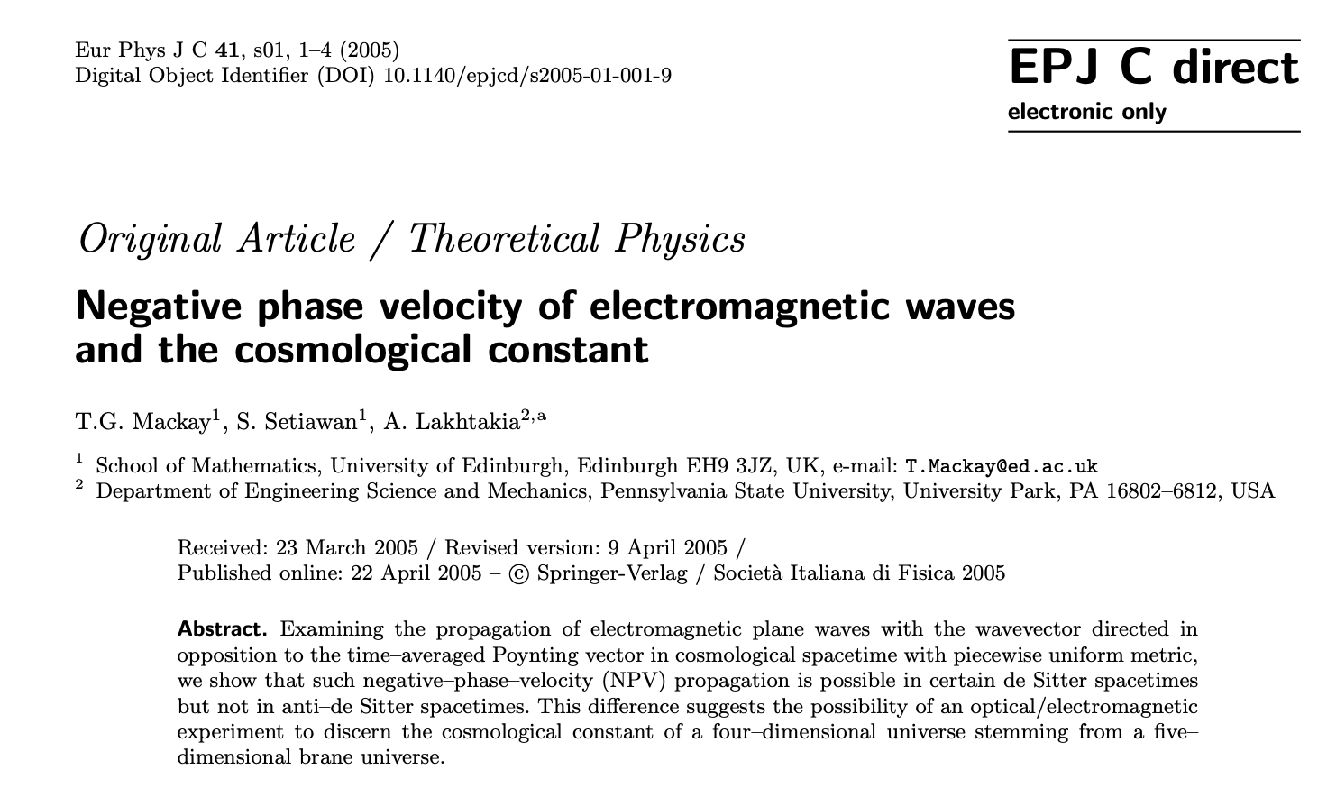
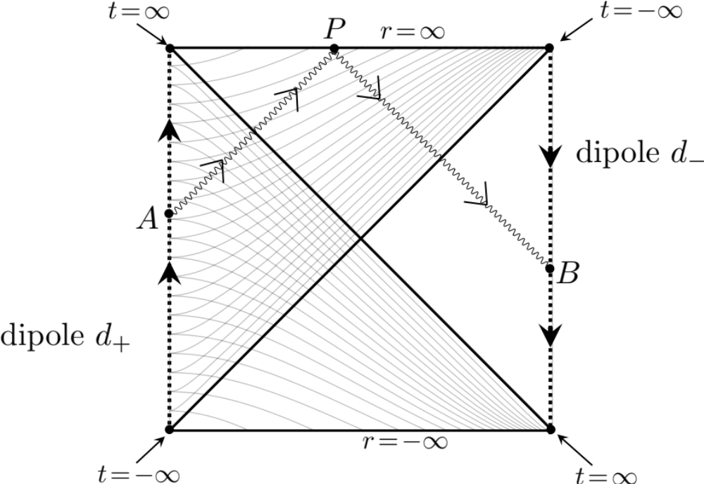

The Poynitng vector for outgoing waves is not necessarily positive
Example: For the most general dipole vibrating in the axial direction:

Slide 19





Thanks!

